Slide 1




CAPSTONE PROJECT 1 COHORT 3 GROUP C
RABIA AZAM
MUHAMMAD ZAEEM
MUHAMMED ALI

Slide 2

E-COMMERCE BUSINESS
Dataset: NORTHWIND STORE DATABASE
Link:
https://code.google.com/archive/p/northwindextended/downloads
Notes:
To replace this picture, just select and delete it. Then use the Insert Picture icon to replace it with one of your own!

Slide 3
.
Step 1 Business information
Step 2 Problems & their solutions
Step 4 queries
Step 3 Charts and graphs

Slide 4
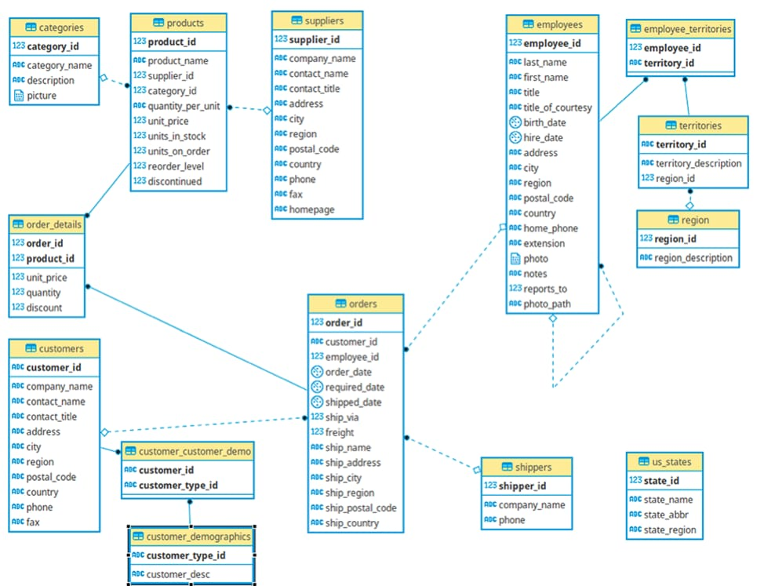
Northwind database Schema:

Slide 5


What is an ecommerce store?
An ecommerce business is any business that buys and sells goods or services over the internet.

Slide 6

Here , we will discuss The most common eCommerce challenges faced and their solutions wHILE building a successful eCommerce platform

Slide 7



DASHBOARD
A dashboard is a visual display of all of your data.
A data dashboard is an analytics tool that helps capture, track, and consume data in a way that is meaningful to your business

Slide 8
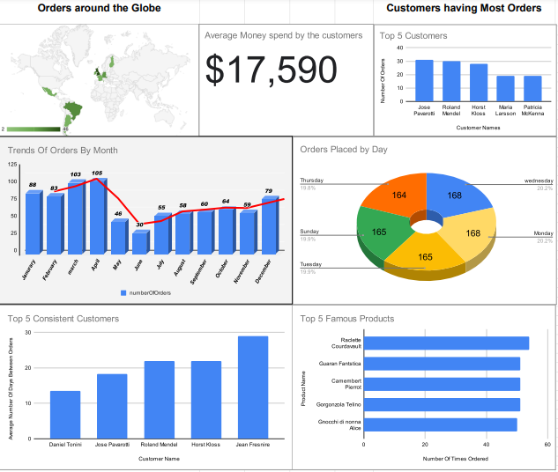

Slide 9
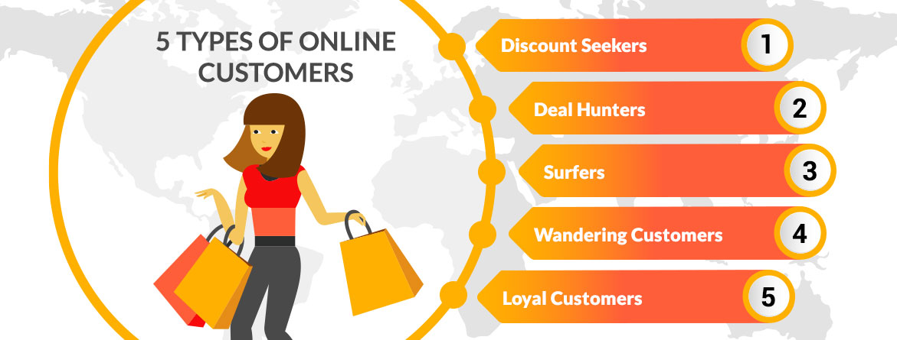
Different types of customers

Slide 10

Customer Retention: Customer retention is the practice of increasing a business's repeat customer rate and extracting additional value from those customers. Customer retention is associated with a customer making repeat purchases, being satisfied with a company's services, and not defecting to that company's competitor

Slide 11
WHAT IS AN AVERAGE MONEY SPENT BY OUR CUSTOMERS ?
Custemer Name | Amount Used
Horst Kloss | $ 117,483
Jose Pavarotti | $ 115,673
Roland Mendel | $ 113,237
Patricia McKenna | $ 57,317
Paula Wilson | $ 52,246

Slide 12

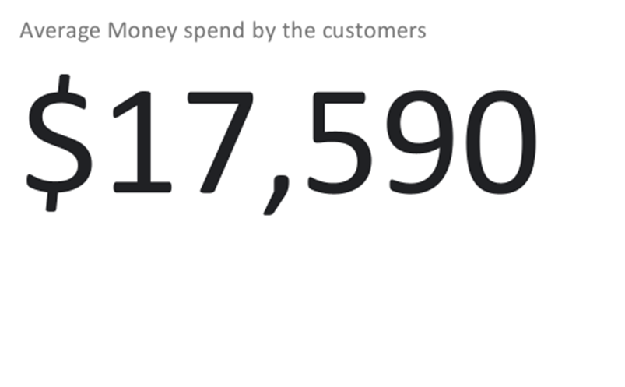
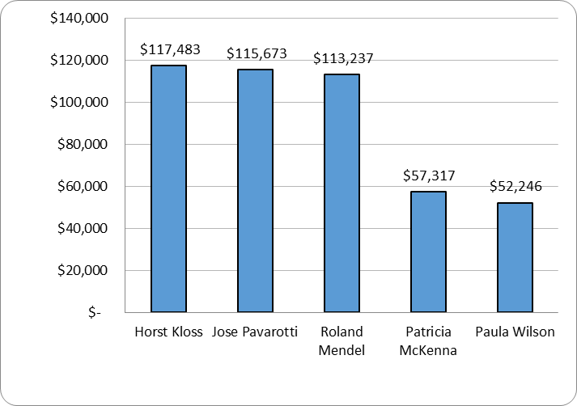
Average money spent by our customer:

Slide 13
What are the Most sold out products ?
Product Name | Sold Quantity
Camembert Pierrot | 1577
Raclette Courdavault | 1496
Gorgonzola Telino | 1397
Gnocchi di nonna Alice | 1263
Pavlova | 1158

Slide 14
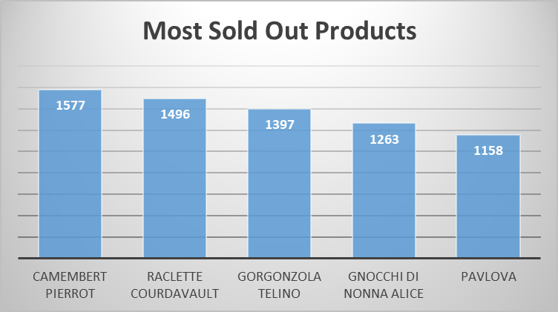

Our most sold out products

Slide 15

Customer loyalty:
Customer loyalty describes an ongoing emotional relationship between you and your customer, manifesting itself by how willing a customer is to engage with and repeatedly purchase from you versus your competitors.
customer loyalty happens when customers give a company repeat business over time. If you provide great value in your product or service, and the customer experience stays consistently good, then your business will reap the benefits of customer retention.

Slide 16
Average number of days v/s orders:
Customer Name | Average Number Of Days By Order
Daniel Tonini | 13.5
Jose Pavarotti | 18.3
Roland Mendel | 21.9
Horst Kloss | 22
Jean Fresnire | 29

Slide 17
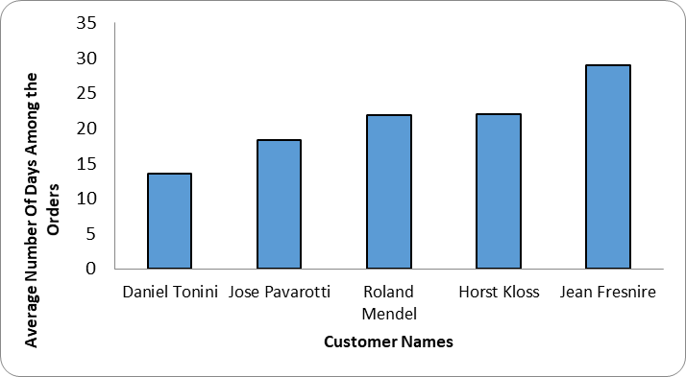
AVERAGE NUMBER OF ORDERS:

Slide 18
WHAT IS TOP 5 FAMOUS PRODUCTS?
Product Name | Number Of Times Ordered
Raclette Courdavault | 54
Guaran Fantstica | 51
Camembert Pierrot | 51
Gorgonzola Telino | 51
Gnocchi di nonna Alice | 50

Slide 19
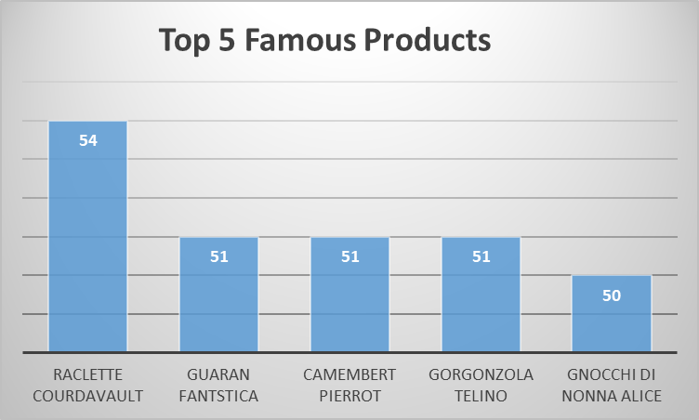

Famous products with respect to number of orders
This Photo by Unknown author is licensed under CC BY-SA-NC.

Slide 20
What Is Recency, Frequency, Monetary Value (RFM)?
Recency, frequency, monetary value is a marketing analysis tool used to identify a company's or an organization's best customers by measuring and analyzing spending habits.
An RFM analysis evaluates clients and customers by scoring them in three categories: how recently they've made a purchase, how often they buy, and the size of their purchases.
RFM analysis helps firms reasonably predict which customers are likely to purchase their products again, how much revenue comes from new (versus repeat) clients, and how to turn occasional buyers into habitual ones.

Slide 21
Recency: How recently a customer has made a purchase
Frequency: How often a customer makes a purchase
Monetary Value: How much money a customer spends on purchases
What Is Recency?
Recency factor is based on the notion that the more recently a customer has made a purchase with a company, the more likely they will continue to keep the business and brand in mind for subsequent purchases. This information can be used to remind recent customers to revisit the business soon to continue meeting their purchase needs.

Slide 22
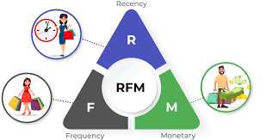
WHAT IS FREQUENCY?
THE FREQUENCY OF A CUSTOMER’S TRANSACTIONS MAY BE AFFECTED BY FACTORS SUCH AS THE TYPE OF PRODUCT, THE PRICE POINT FOR THE PURCHASE, AND THE NEED FOR REPLENISHMENT OR REPLACEMENT. PREDICTING THIS CAN ASSIST MARKETING EFFORTS DIRECTED AT REMINDING THE CUSTOMER TO VISIT THE BUSINESS AGAIN.
WHAT IS MONETARY VALUE?
MONETARY VALUE STEMS FROM HOW MUCH THE CUSTOMER SPENDS. A NATURAL INCLINATION IS TO PUT MORE EMPHASIS ON ENCOURAGING CUSTOMERS WHO SPEND THE MOST MONEY TO CONTINUE TO DO SO. WHILE THIS CAN PRODUCE A BETTER RETURN ON INVESTMENT IN MARKETING AND CUSTOMER SERVICE, IT ALSO RUNS THE RISK OF ALIENATING CUSTOMERS WHO HAVE BEEN CONSISTENT BUT HAVE NOT SPENT AS MUCH WITH EACH TRANSACTION.

Slide 23

WHO IS YOUR TOP 5 CUSTOMERS ?
Customer Name | Number OF Orders
Jose Pavarotti | 31
Roland Mendel | 30
Horst Kloss | 28
Maria Larsson | 19
Patricia McKenna | 19

Slide 24
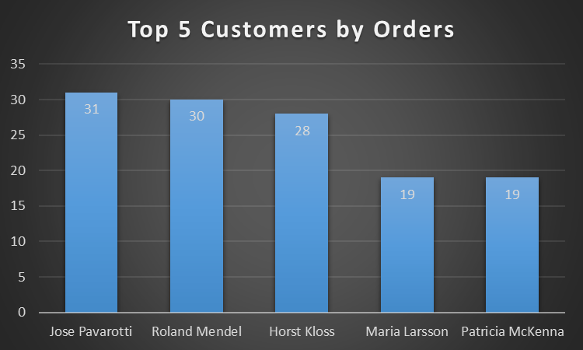

Slide 25

WHICH DAYS ARE THE MOST PRODUCTIVE ONES ?
DAYS | ORDERS
MONDAY | 20.2%
TUESDAY | 19.9%
WEDNESDAY | 20.2%
THURSDAY | 19.8%
FRIDAY | 0%
SATURDAY | 0 %
SUNDAY | 19.9%

Slide 26
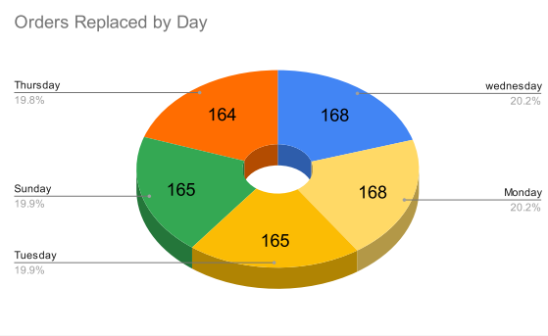
Order placed with respect to DAYs:

Slide 27
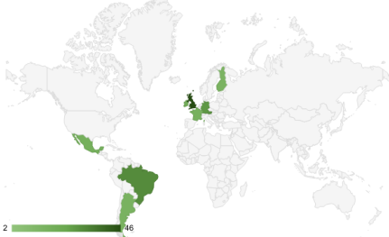
WHICH CITY HAS HIGHEST NUMBER OF ORDERS?

Slide 28
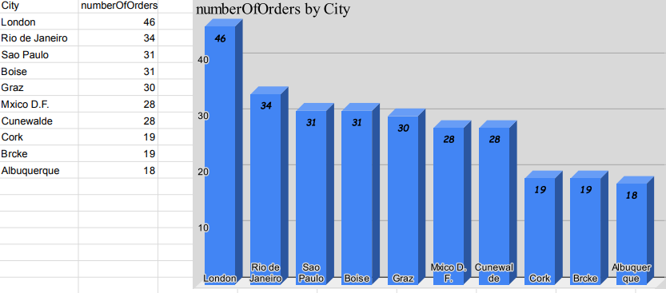
Number of orders by city

Slide 29


WHAT IS THE TRENDLINE FOR ORDERS?

Slide 30
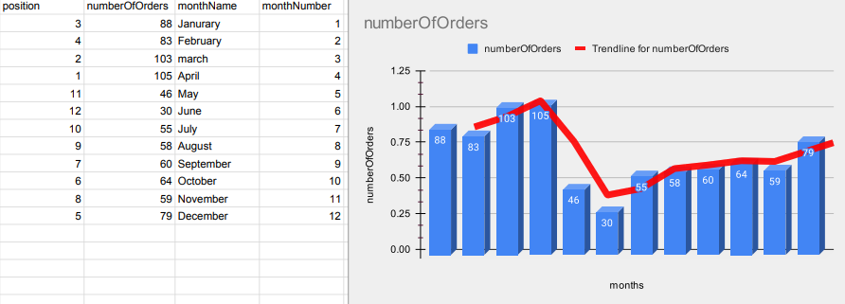
TRENDLINE FOR NUMBER OF ORDERS:

Slide 31

QUERIES :

Slide 32


